Slide 1
Reinforced concrete 2
By
Dr. Heba Mohamed Issa

Slide 2
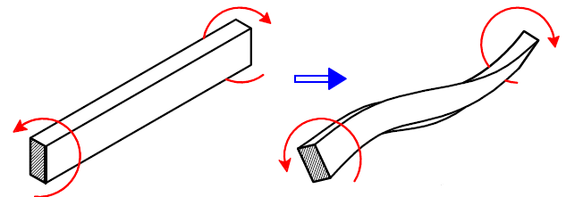
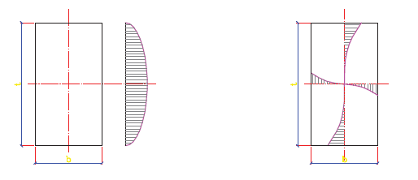
Design of Section Subjected to Torsion Moment
Shear stresses are resulted from:
Shear force (Q)
Torsional Moment (M)

Slide 3
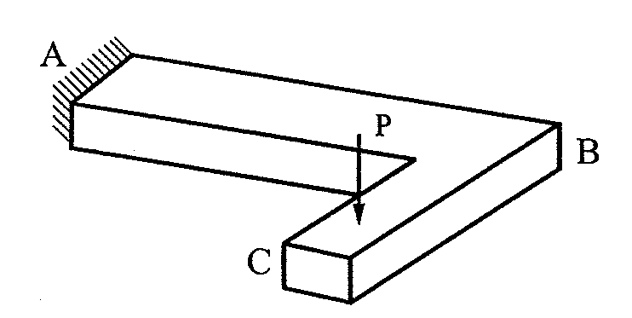
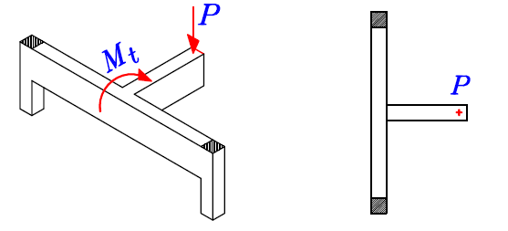
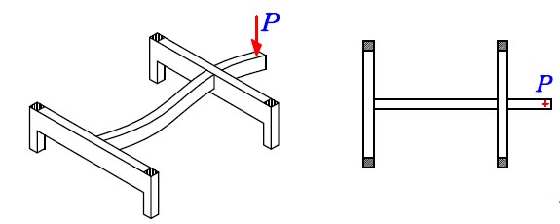
Examples to sections subjected to torsion moment
No torsion

Slide 4
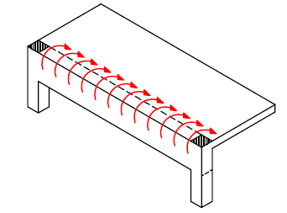
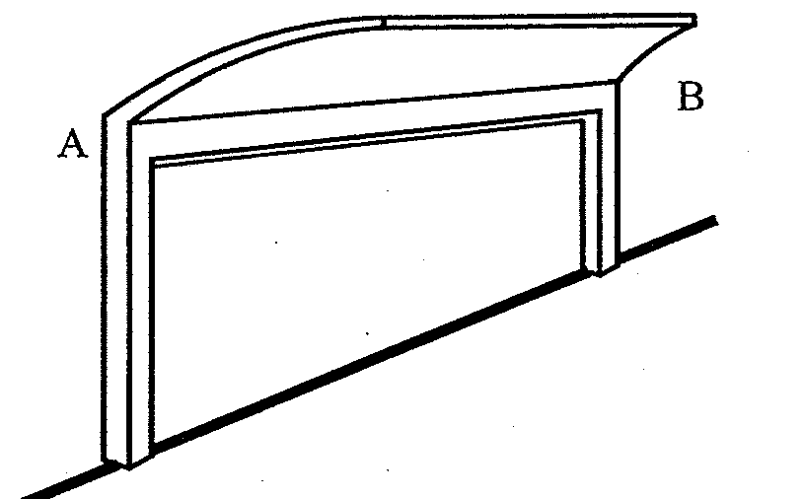
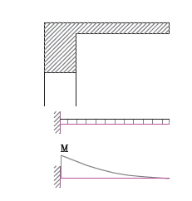
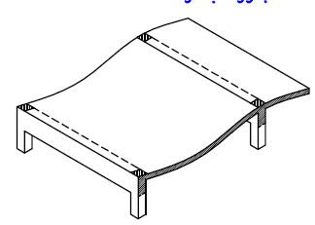
But
No torsion

Slide 5
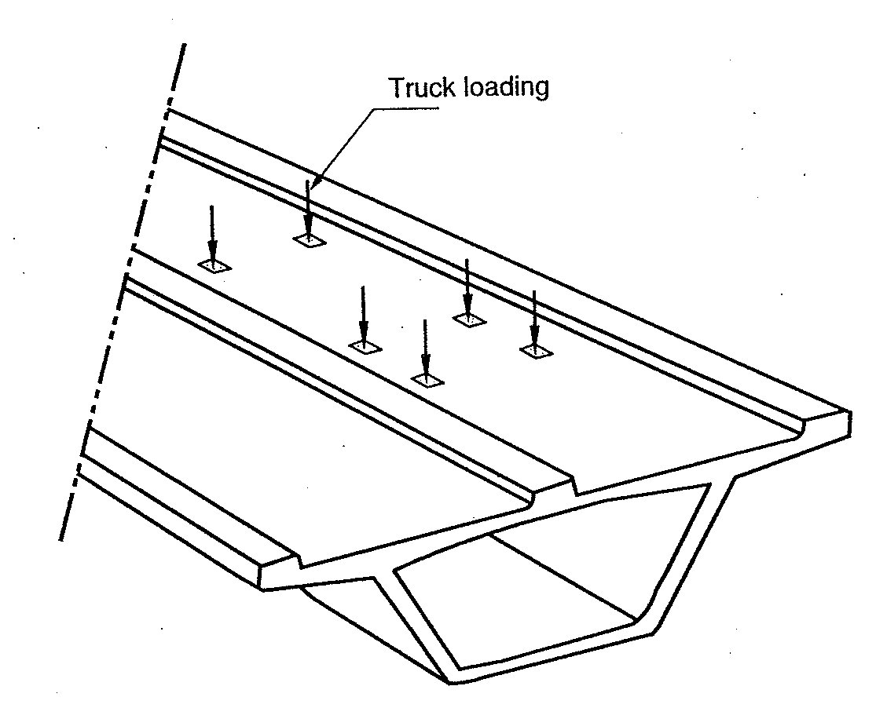

Slide 6
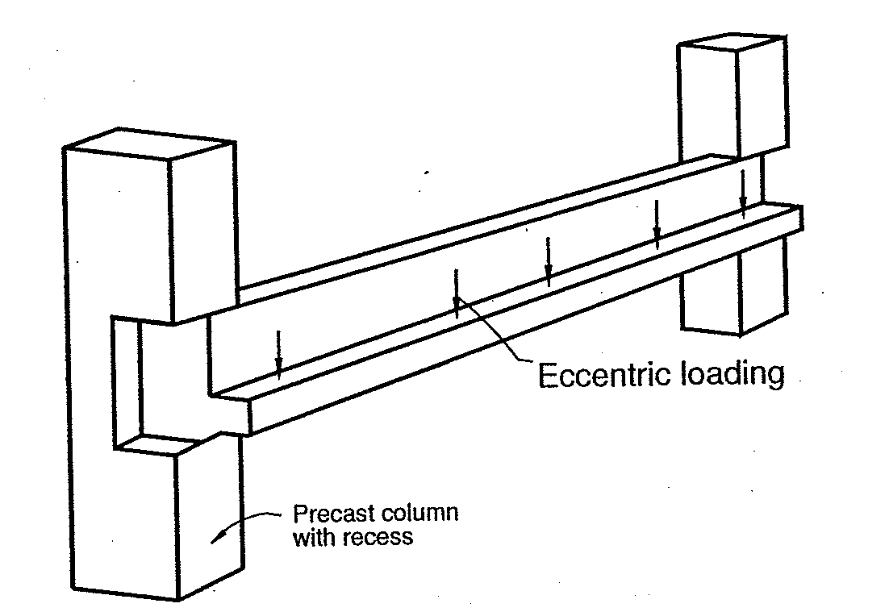

Slide 7
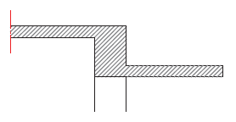
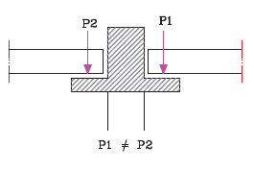
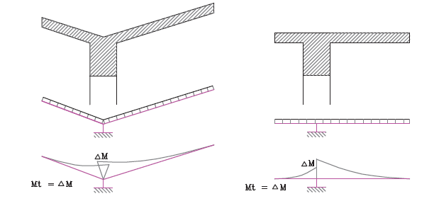

Slide 8
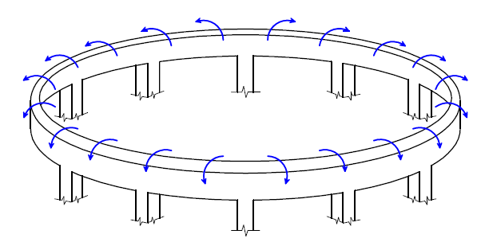

Slide 9
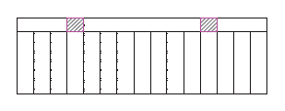

Slide 10
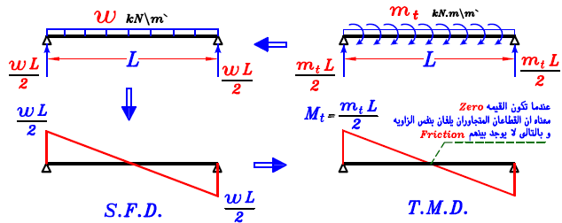
Torsion Moment Diagram
To draw torsion moment diagram (T.M.D), we consider Mt as load (concentrated or distributed) and draw S.F.D. for that load.
Ex 1:

Slide 11
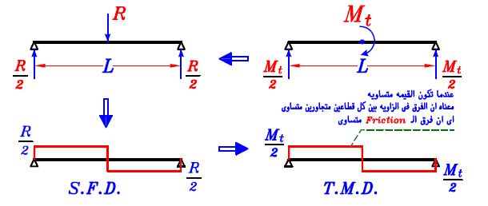
Ex 2:
Ex 3:

Slide 12
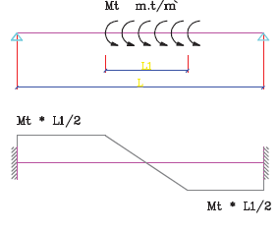
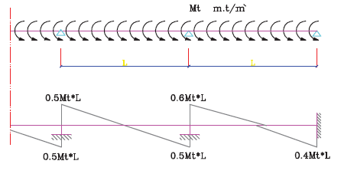
Ex 4:
Ex 5:

Slide 13
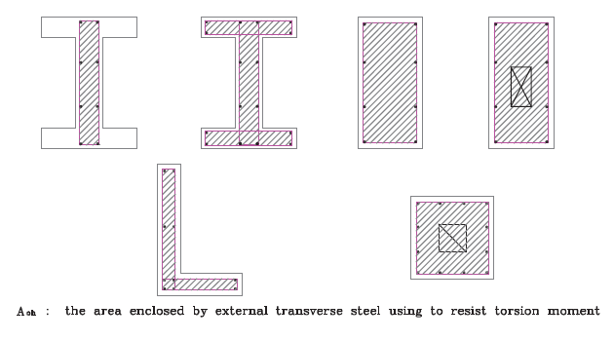
Design of section due to shear stress of shear and torsion
Calculate shear stresses of torsion and shear in cross sections.
Where : A_{o} = 0.85 A_{oh}
t_{e} = A_{oh}/P_{h}

Slide 14
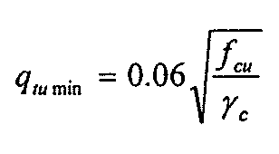
torsion
shear
Check if:
Where:
Check if:
Where:
≤ 4

Slide 15
torsion
shear
2. Calculate torsion RFT
RFT of torsion consists of:
Closed stirrups
2. Calculate shear RFT stirrups
Where : A_{o} = 0.85 A_{oh}
t_{e} = A_{oh}/P_{h}

Slide 16
torsion
shear
B. Longitudinal Bars

Slide 17
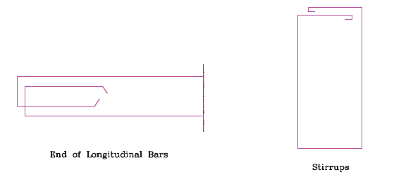
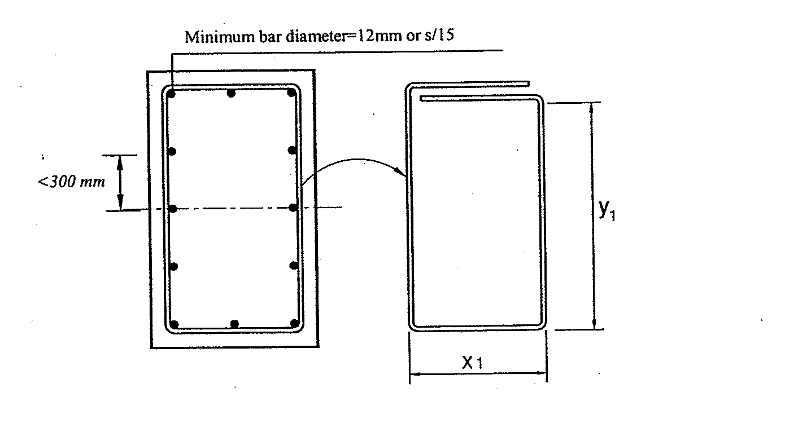
Notes:

Slide 18
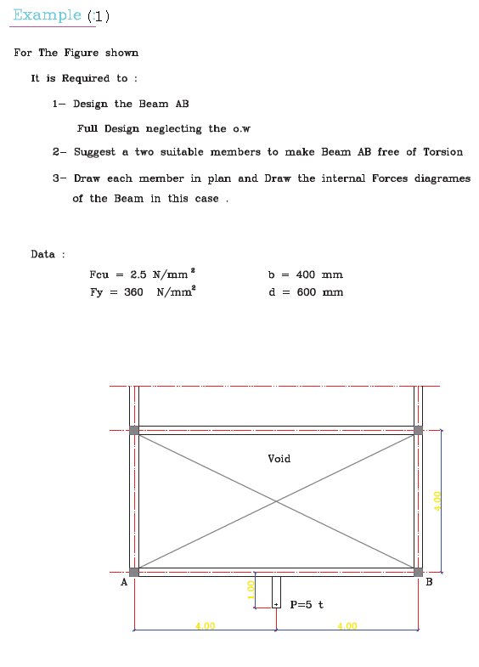

Slide 19
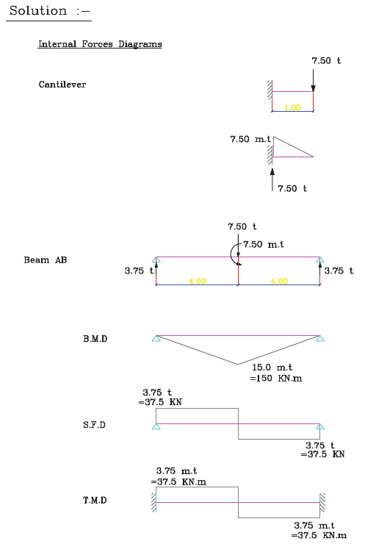

Slide 20
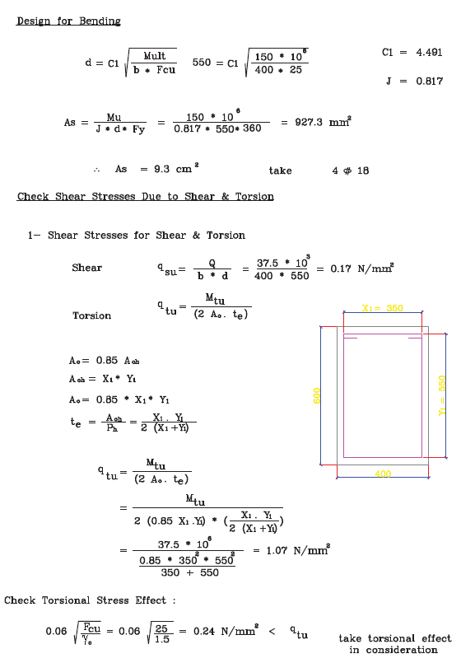

Slide 21
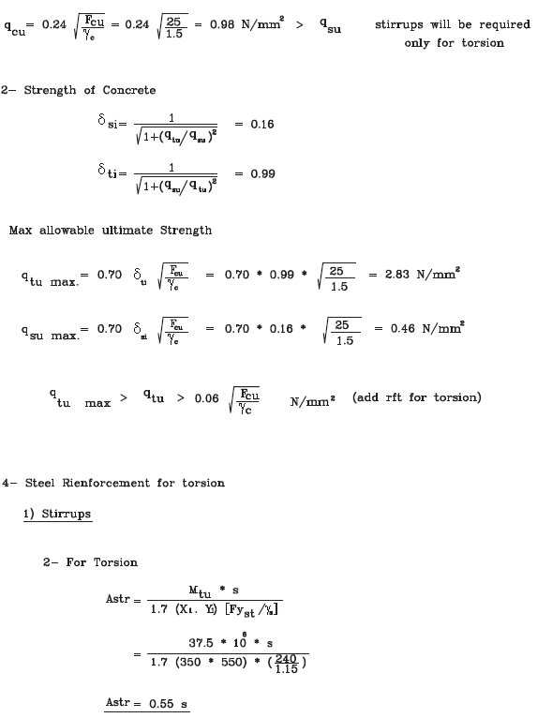

Slide 22
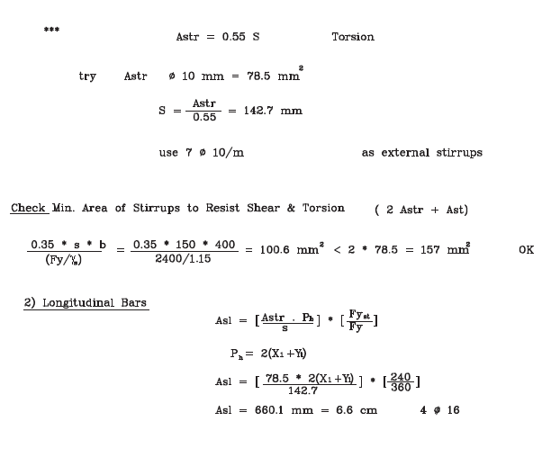

Slide 23
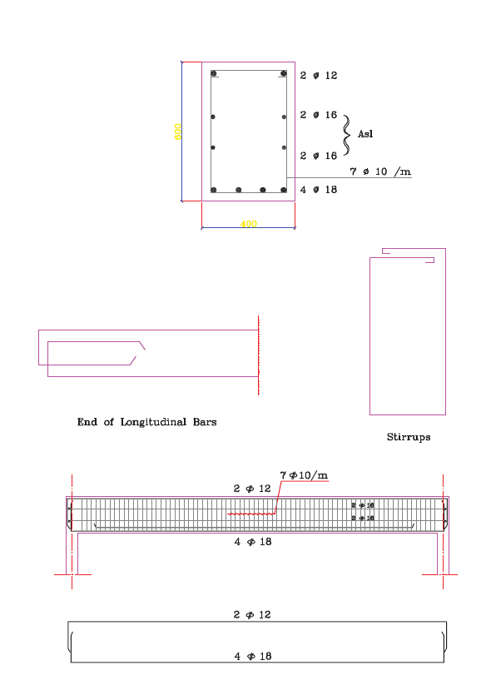

Slide 25
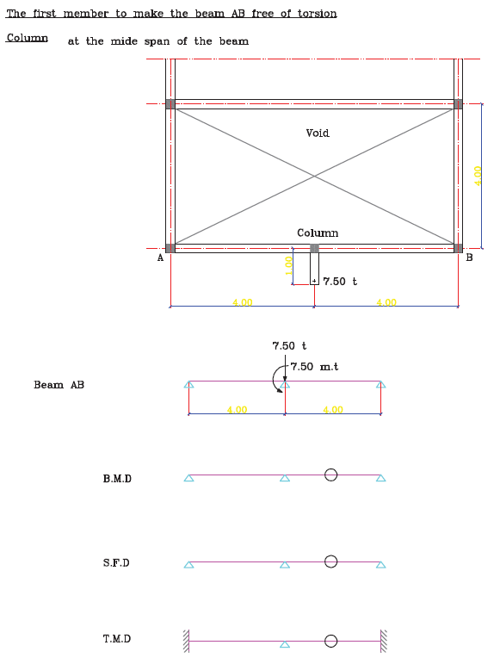

Slide 26
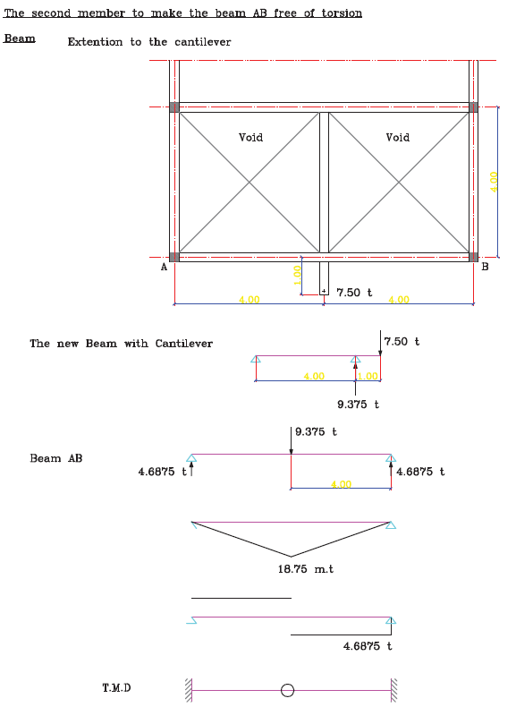

Slide 27
?

Slide 28
Thank you

